Slide 1
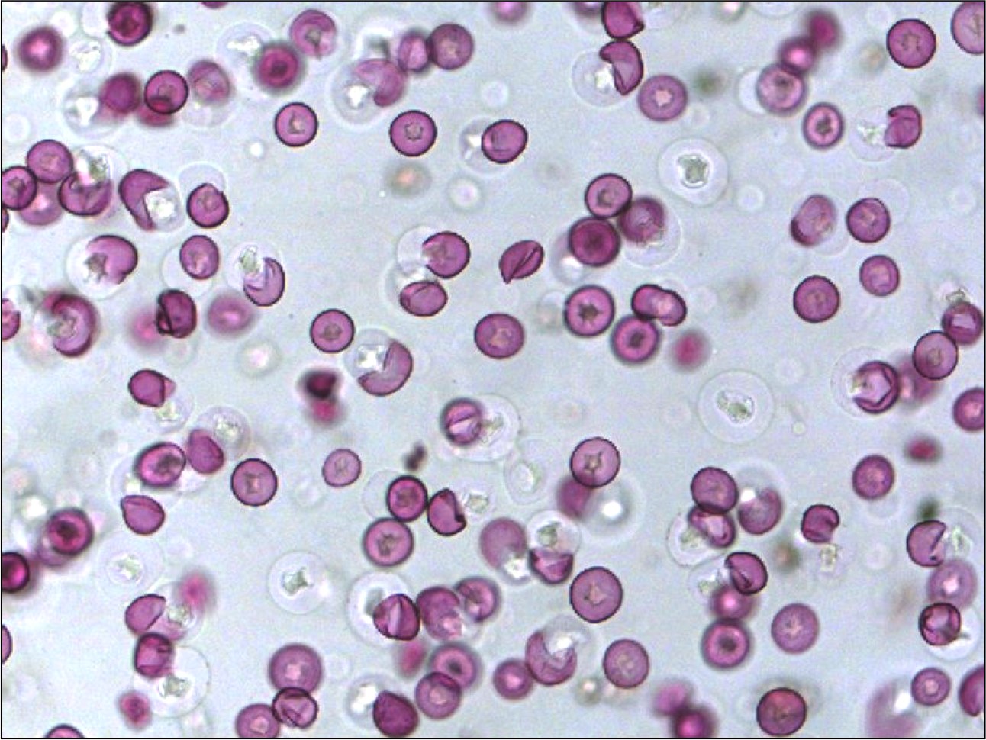
Integrating Airborne Dust Forecasting and Remote Sensing into Air Quality and Public Health Decision Support Services
Jeffrey C Luvall Marshall Space Flight Center
William A. Sprigg, & Slobodan Nickovic,
Anup Prasad, Chapman University
Ana Vukovic and Miram Vujadinovic University of Belgrade, Serbia
Estelle Levetin & Landon Bunderson Dept. Biology University of Tulsa
Peter K. Van de Water California State University, Fresno
Amy Budge & Bill Hudspeth Earth Data Analysis Center, University of New Mexico
Alfredo Huete, University of Technology Sydney
Alan Zelicoff, St. Louis University & ARES Corporation
Theresa Crimmins & Jake Weltzin USGS National Phenology Network
Heide Krapfl and Barbara Toth, New Mexico Department of Health

Slide 2
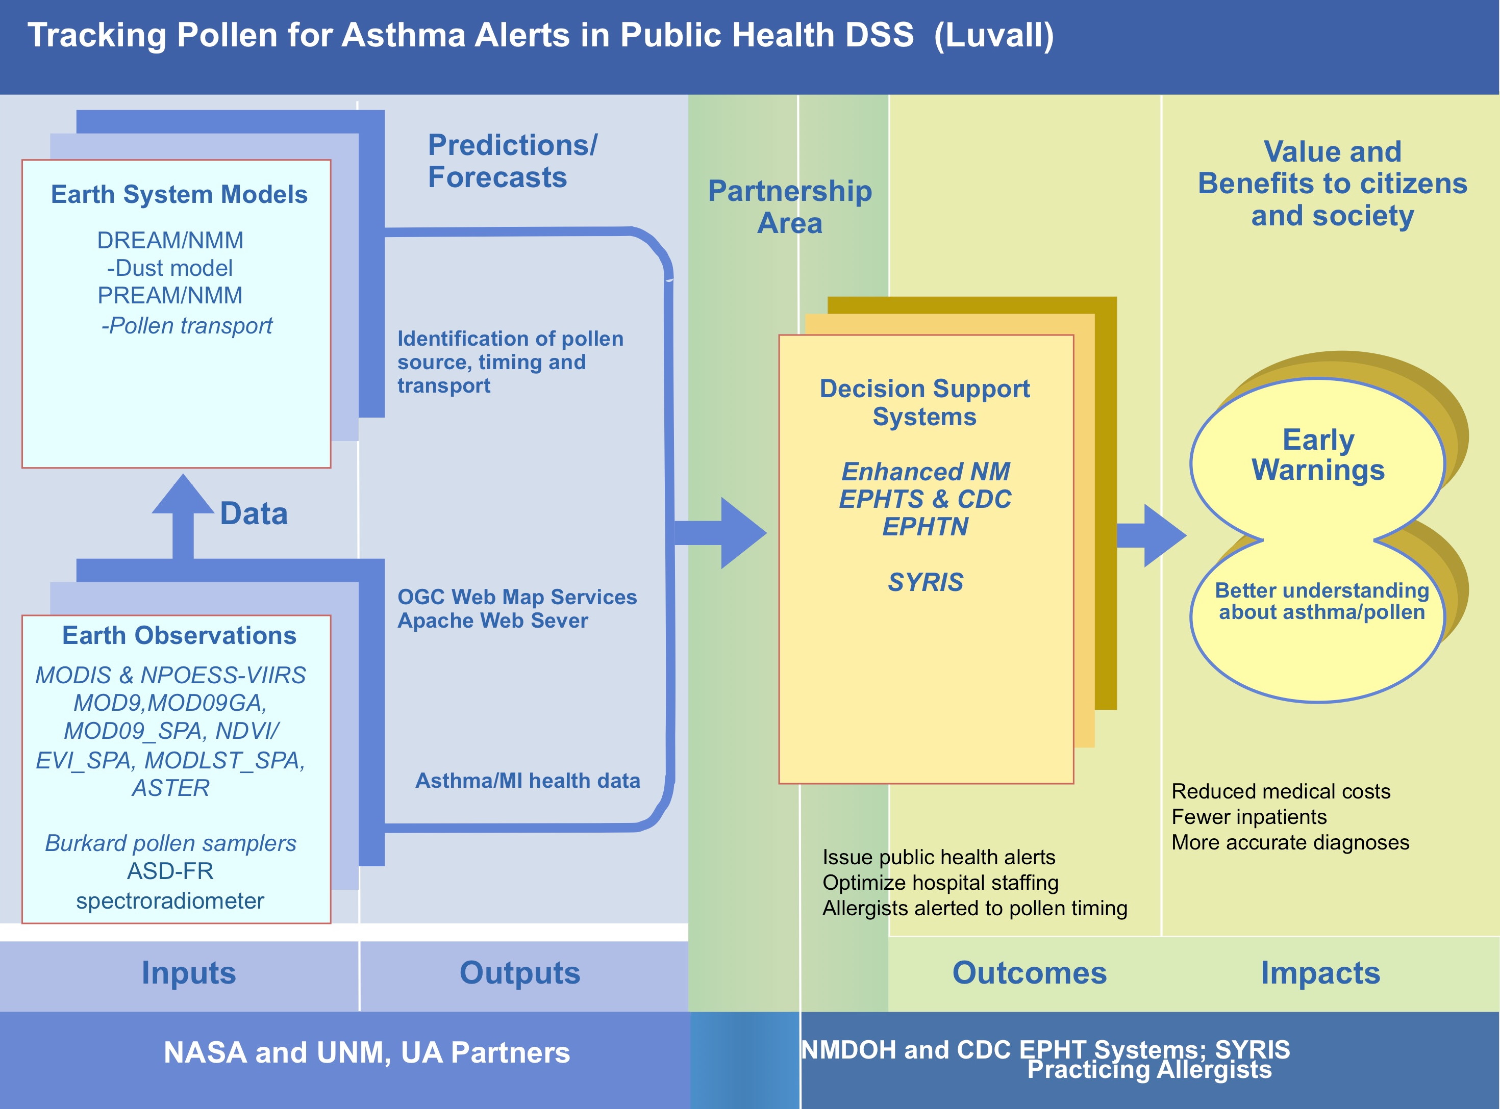

Slide 3


Slide 4
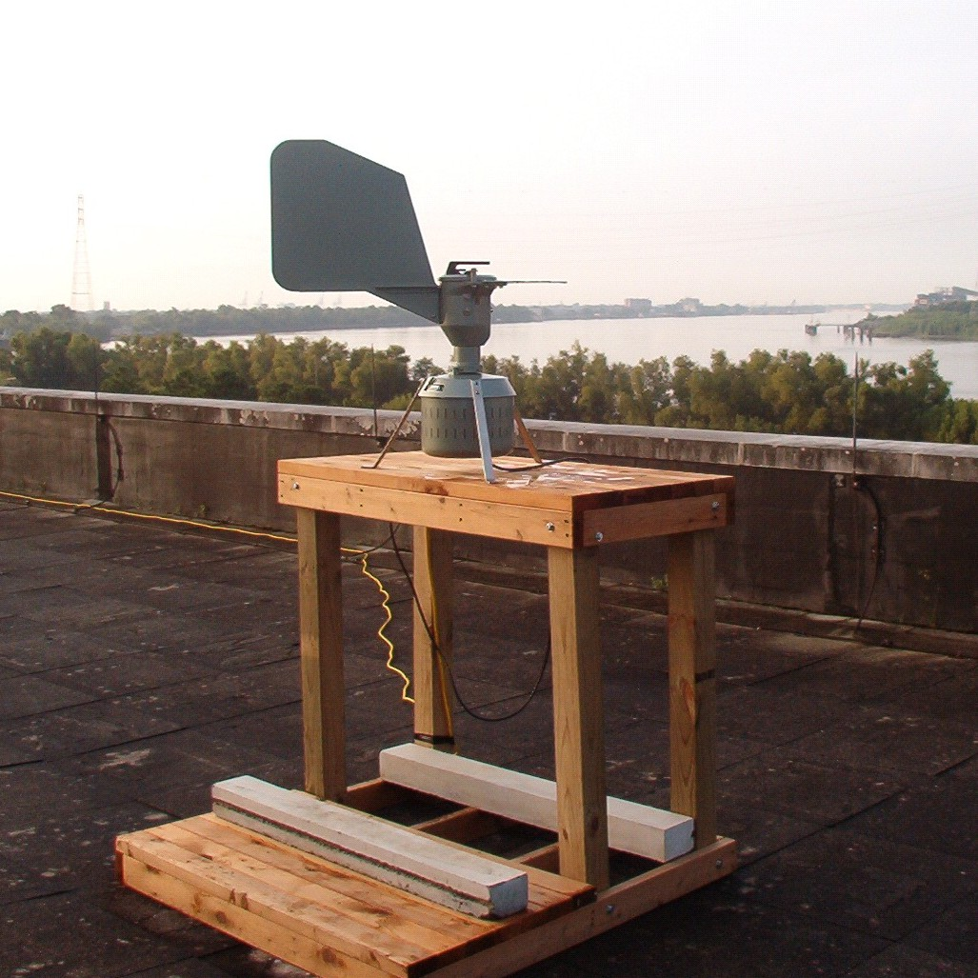
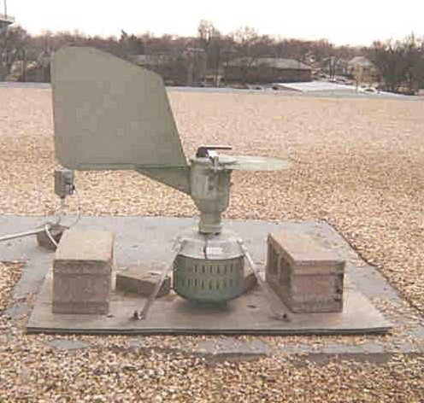
Burkard Spore Trap

Slide 5
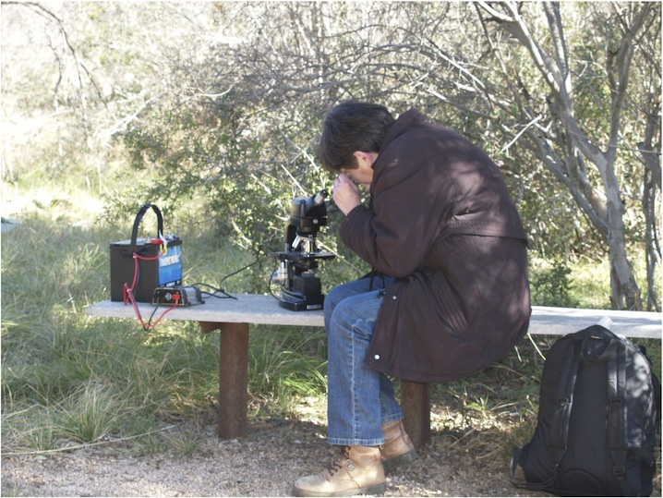

Slide 6
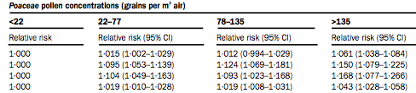

Pollen and Respiratory Disease:
What little is known²
Increase in mortality of these disorders:
    High concentrations of pollen allergens have also been shown to occur in thoracic particles (<10 microns in diameter) and respirable particles (<2·5 microns and these correlated well in time with airborne pollen concentrations. … airborne pollen results in exposure of the lower airways and lung to pollen allergens.
    The association between air pollution and the number of daily deaths may be related to the inflammatory potential of very small particles
    …suggests that high airborne pollen concentrations, which nowadays are mainly seen as triggers of allergic symptoms, may have far more serious effects than previously thought.”
² Bert Brunekreef, Gerard Hoek, Paul Fischer, Frits Th M Spieksma. Relation between airborne pollen concentrations and daily cardiovascular and respiratory-disease mortality. Lancet Vol 355 (2000): 1517-8.

Slide 7
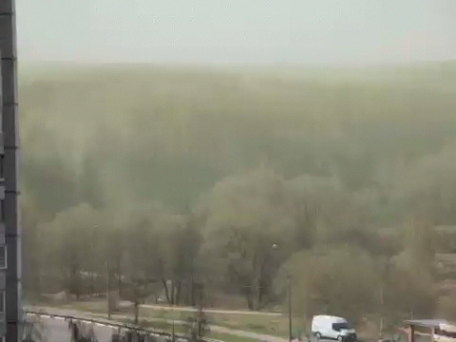
Moscow Birch Pollen

Slide 8
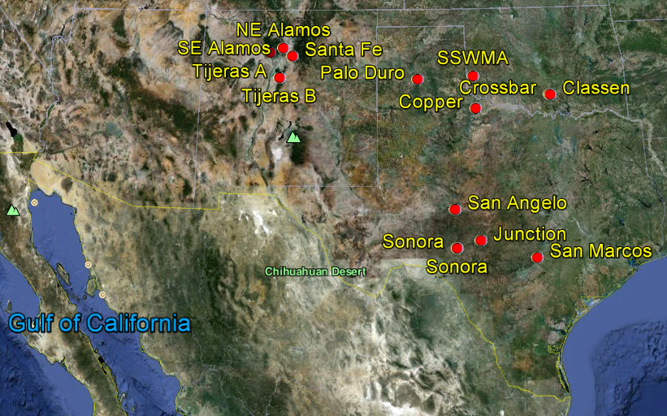

Slide 9
Juniper Species and Pollination Season
Juniper Ashei (J_{a}) is mostly found to be distributed over Texas and Oklahoma and pollinates during December to January. Thus, the dispersion of juniper pollens during December-January is mostly restricted to J_{a} type..
Juiper Pinchotti (J_{p}) is mostly distributed over Texas and pollinated during October-November. Thus, the dispersion of juniper pollens during this period is mostly restricted to J_{p} type.
Juniper monosperma (J_{m}) and Juniper scopulurum (J_{s}) are prevalent in New Mexico and pollinates during March-April period. Thus, the dispersion of juniper pollens during this period is mostly restricted to J_{m} and J_{s} type.

Slide 10
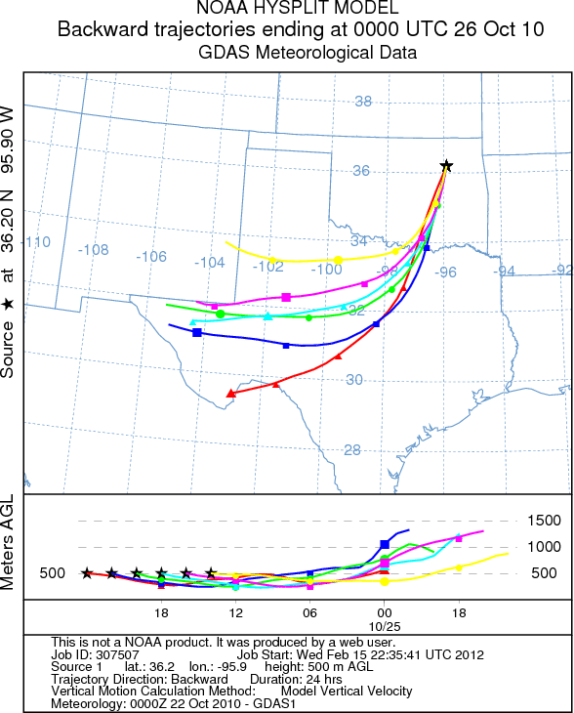
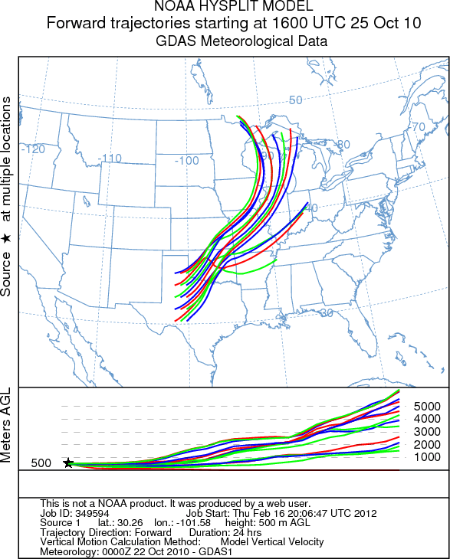
Trajectory analysis indicates the pollen originated in southwest Texas approximately 8 hours earlier

Slide 11
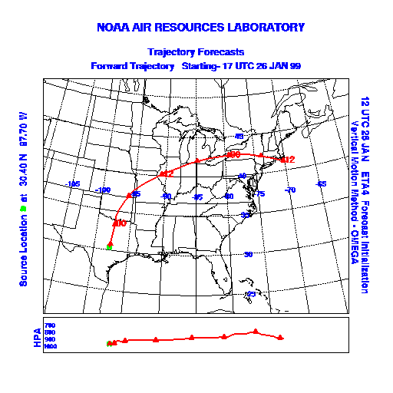
Continental transport
27 Jan 99, Jim Anderson in London, Ontario reported atmospheric Juniperus pollen - 58 pollen grains/m³
Trajectories show that the source of this pollen was Texas population of Juniperus ashei
Our Jan 26 forecast indicated that the “pollen has the potential to travel very long distances.”
Van de Water et. al 2003

Slide 12
Climate Effects and Aeroallergens
Long Term Climate Variability
  Plant Distribution Changes
  Plant Phenology Changes
  Plant Growth and Productivity Increases
  Pollen Increase
  Increases in Allergen Level
Short Term Climate Variability
  Climate variability and extreme weather events can also affect airborne pollen and spores levels

Slide 13
Pollen Forecasting
Simplest models based on previous years’ pollen data
Phenology models based on flower development
  Start-date forecasts for spring pollen based on winter weather
  Growing degree days calculated from past data
  Remote sensing to determine “greening”
Day to day forecasting models use meteorological conditions and phenology
  Statistical models to identify meteorological factors
  May incorporate dispersion models to show where pollen is going to travel
Yearly severity based on preseason meteorological data – often previous summer

Slide 14
Influence of Preseason Meteorological Variables
Start date
  Significantly correlated with mean monthly temperature in December (r = 0.467, p = 0.038) and November rainfall (r = 0.468, p = 0.038)
Cumulative Season Total (CST)
  Significantly correlated with mean maximum temperature in December (r = 0.4740, p = 0.035)

Slide 15
Limitations of Pollen Sampling
Lack of stations
Count frequency & reporting lag time
Different sampling instruments Rotorod Sampler/Burkard Spore Trap
Only indentifiable pollen “grains”
Expertise in counting/indentification
Refusal to release sampling information-”We do not reveal the sources for our data for privacy and proprietary, competitive reasons. Some pollen counts are conducted privately, and are not meant to be broadcast to the public”

Slide 16
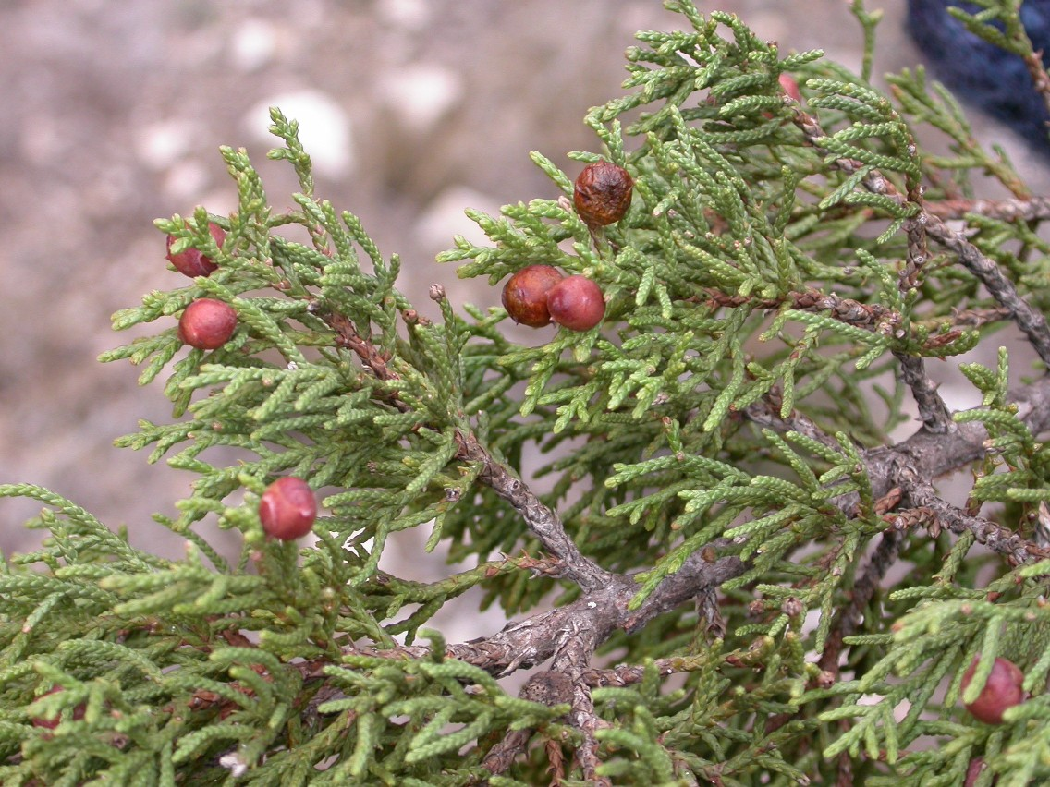
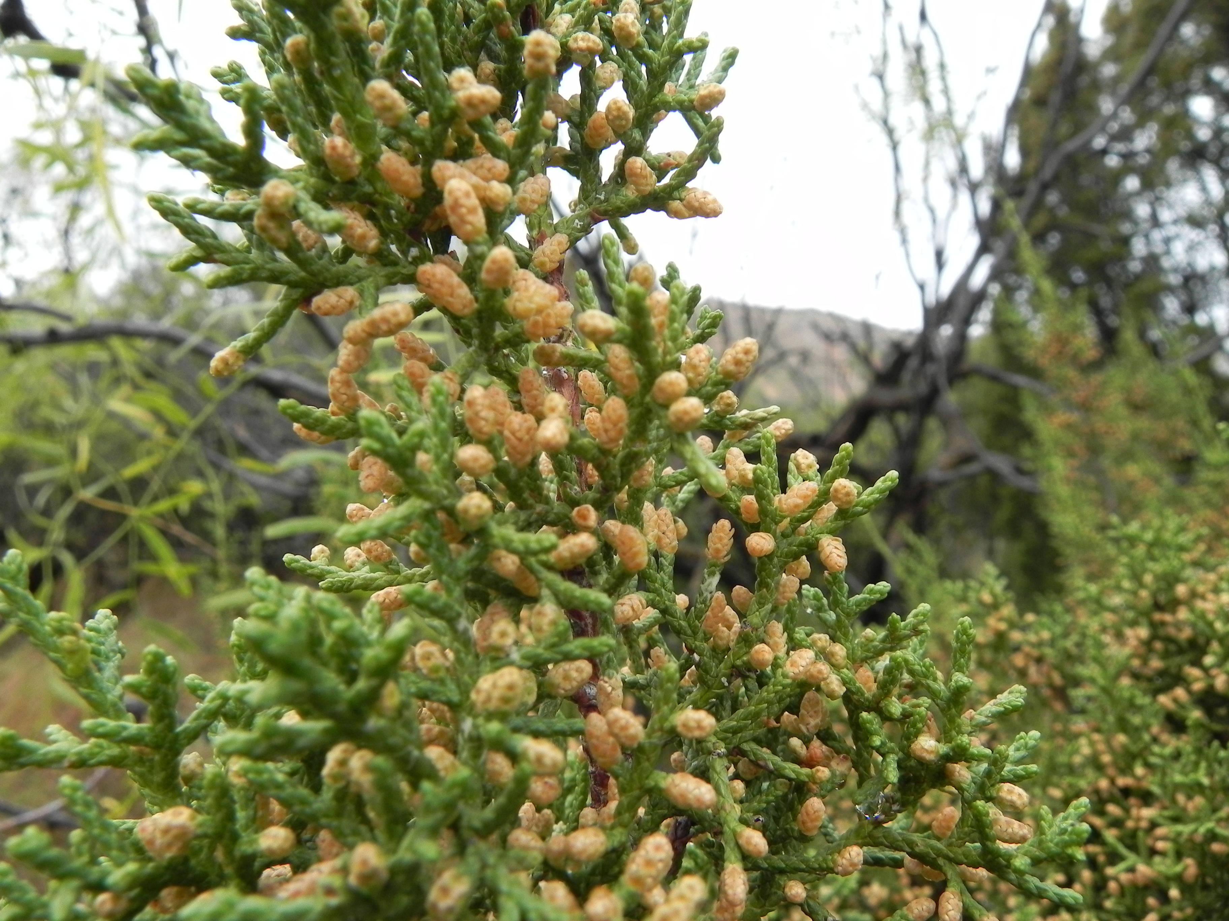
Seed Cones and Pollen Cones of Juniperus pinchotii (Red Berry Juniper)
Fall Pollinating Juniper – mid September to late November

Slide 17
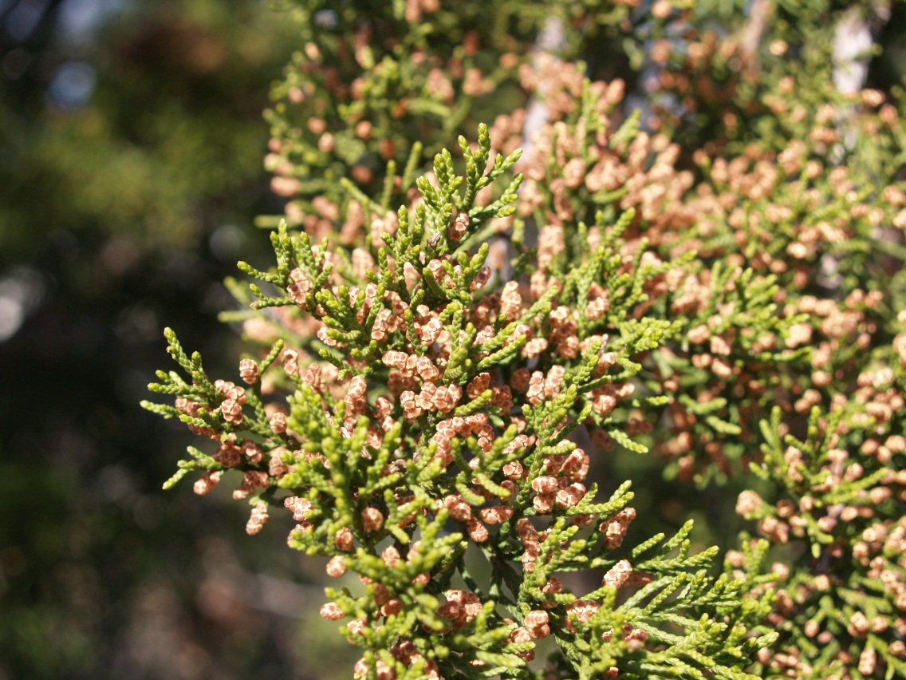
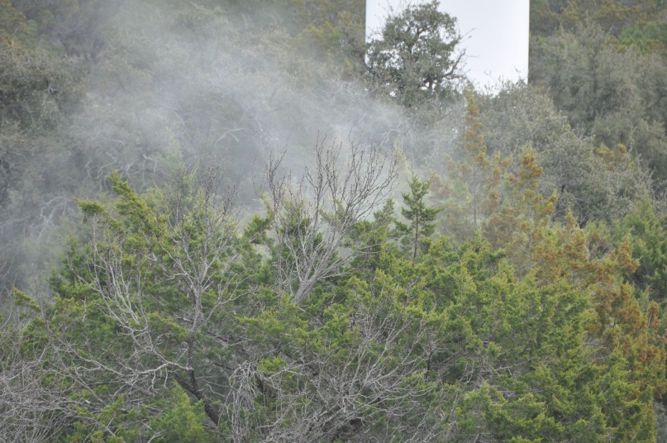
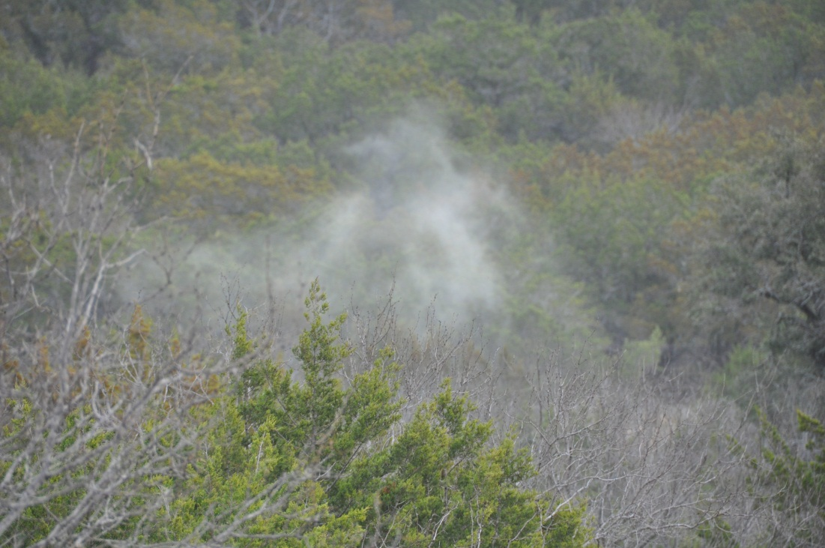
Pollen Release

Slide 18

Pollen per cone
Sonora 472,000 pollen grains/cone
Dallas 402,000 pollen grains/cone
San Marcos 374,000 pollen grains/cone
Junction 363,000 pollen grains/cone
269,946 to 946,646 cones per tree
160 to 1500
Trees/Ha

Slide 19
Summary Statistics for 2010 and 2011 Juniperus pinchotii pollen seasons at source
Location | Average daily concentration Pollen grains/m3 | Peak daily concentration Pollen grains/m3 | Date of peak | Peak hourly concentration Pollen grains/m3 | Time of peak hour | Date of peak hour
2010
Erick, OK | 337 | 5,563 | 25-Oct | 15,898 | 10:00 AM | 25-Oct
Sonora, TX | 286 | 3,019 | 25-Oct | 12,152 | 10:00 AM | 25-Oct
San Angelo, TX | 653 | 5,542 | 1-Nov | 10,195 | Noon | 1-Nov
2011
Erick, OK | 12 | 214 | 16-Oct | 800 | 10:00 AM | 16-Oct
Sonora, TX | 64 | 428 | 26-Oct | 2,422 | 10:00 AM | 31-Oct
San Angelo, TX | 60 | 493 | 26-Oct | 2,747 | 4:00 AM | 26-Oct
Quanah, TX | 22 | 190 | 19-Oct | 703 | 8:00 PM | 19-Oct

Slide 20
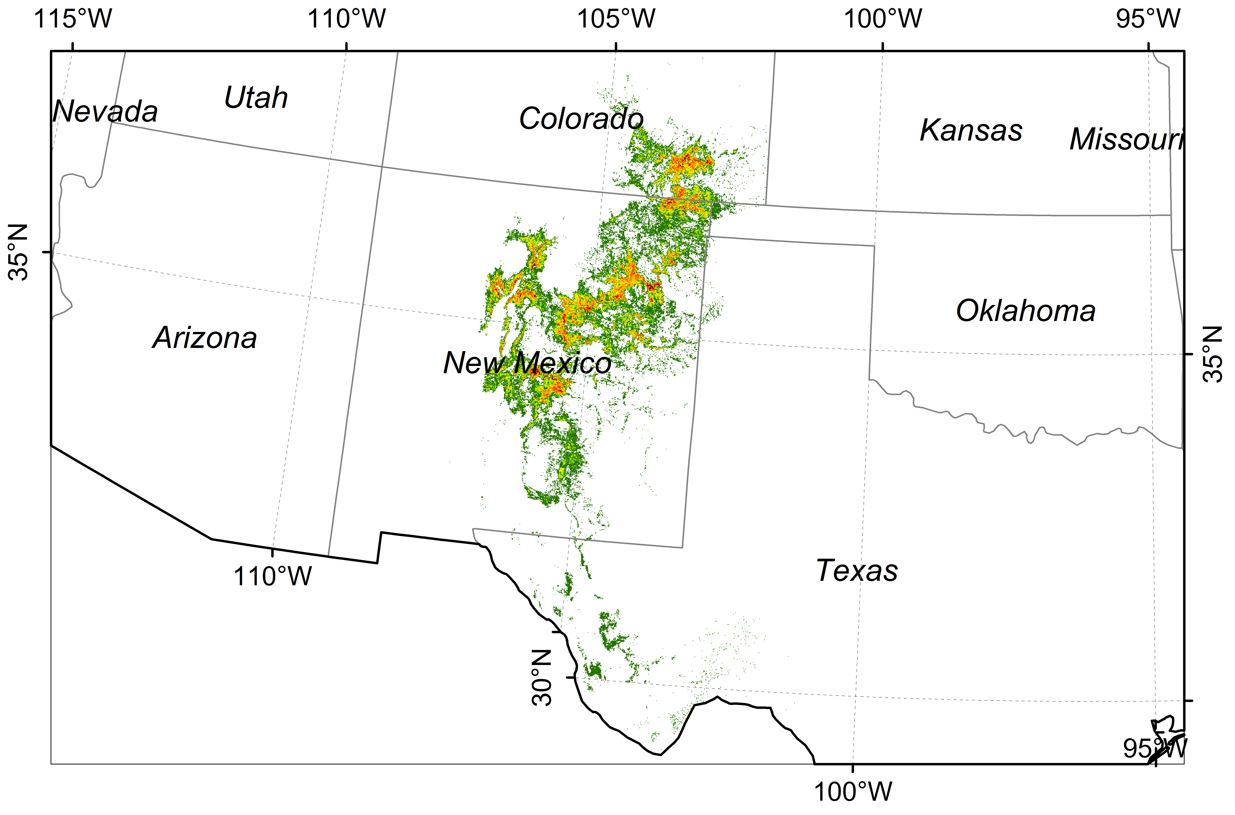
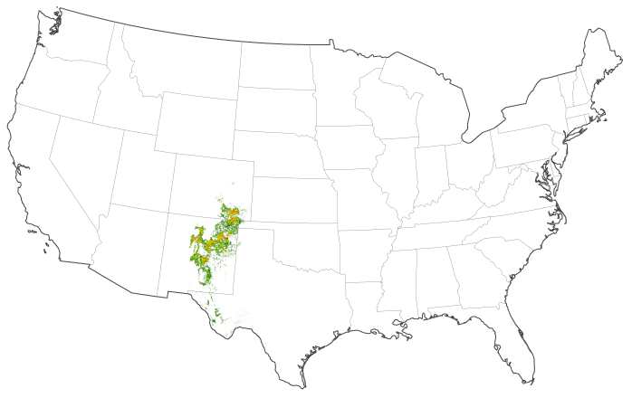
Southern Rocky Mountain Juniper Woodland and Savanna

Slide 21
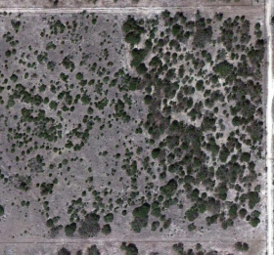
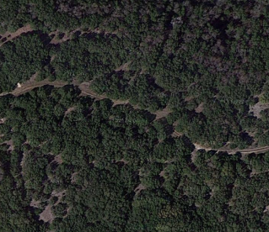
Diversity of J. ashei locations
Sonora
Balcones

Slide 22
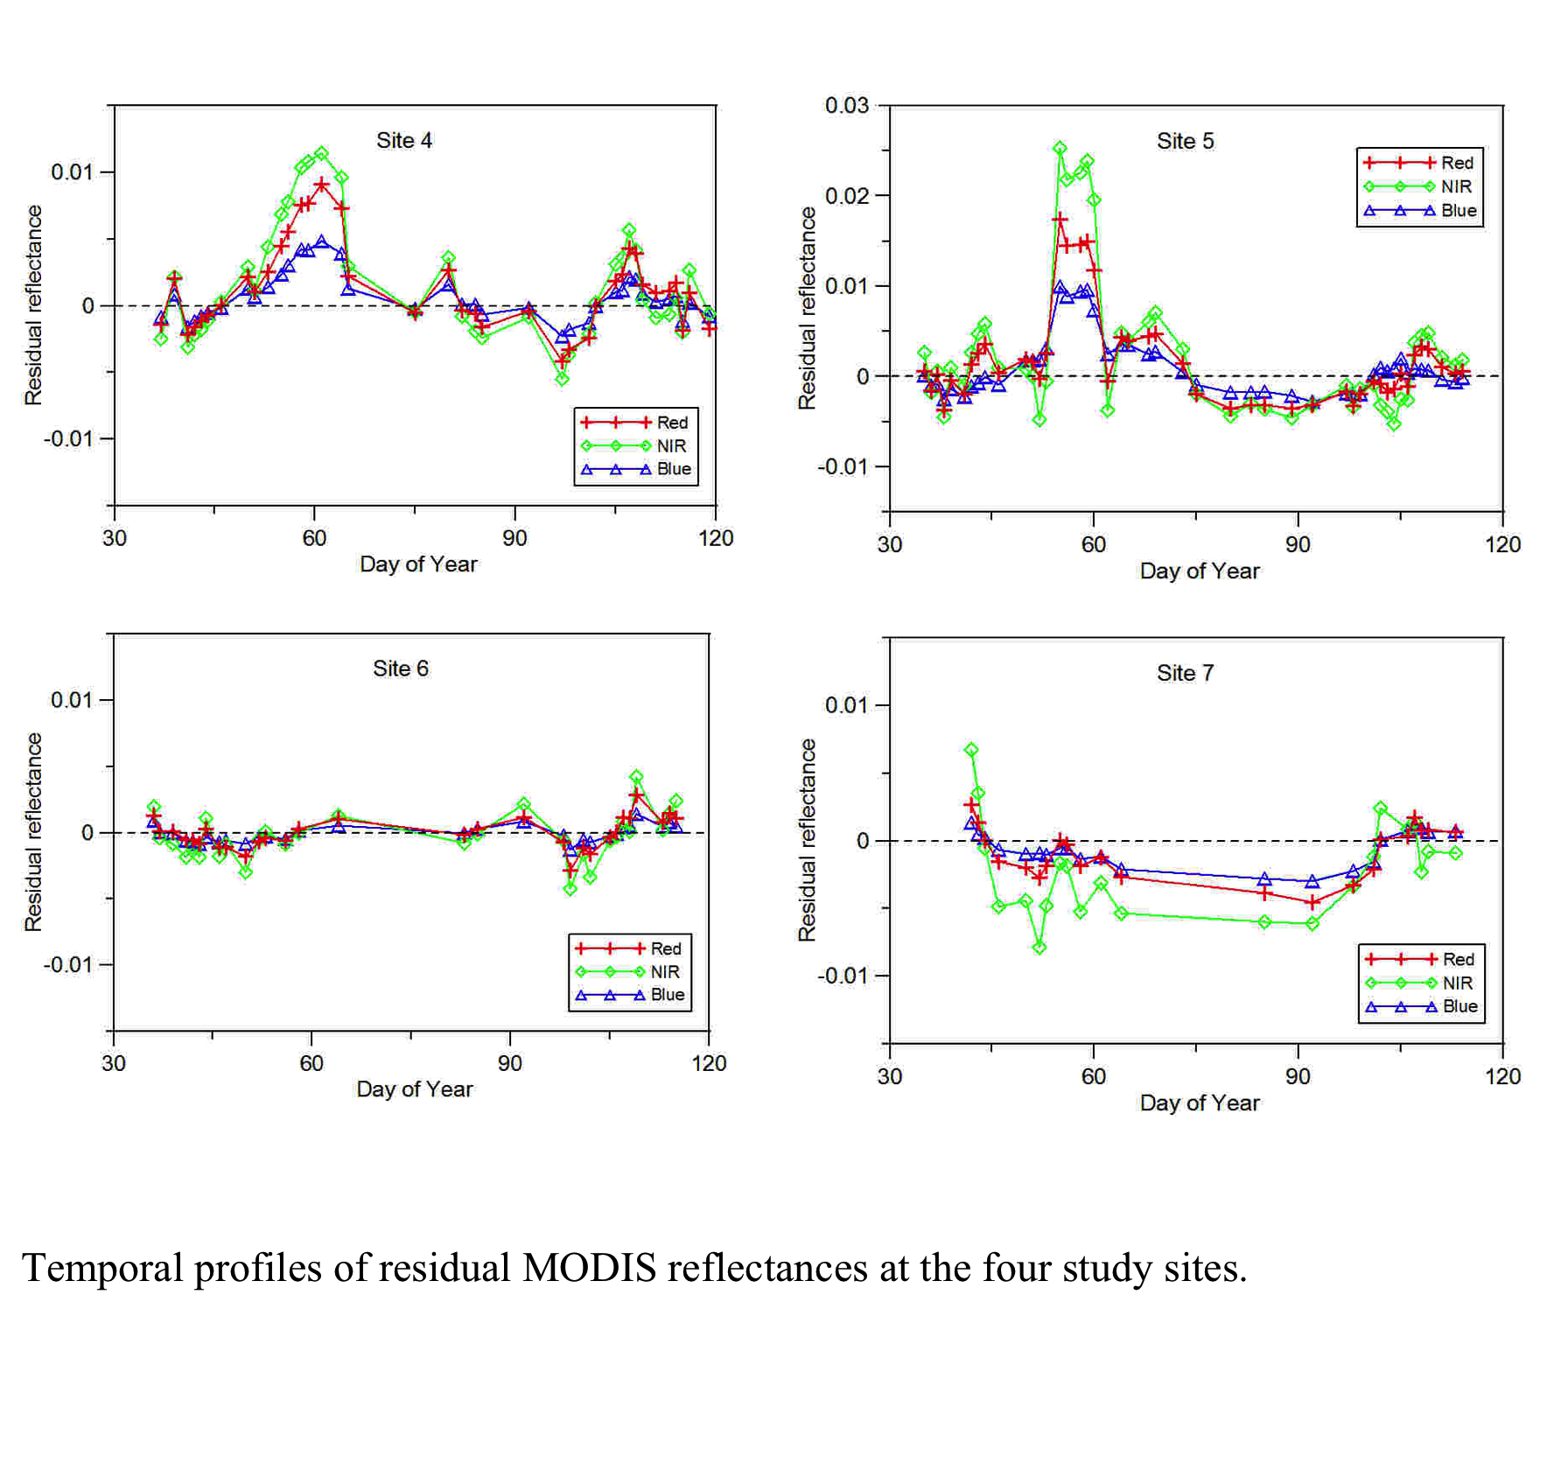

Slide 23
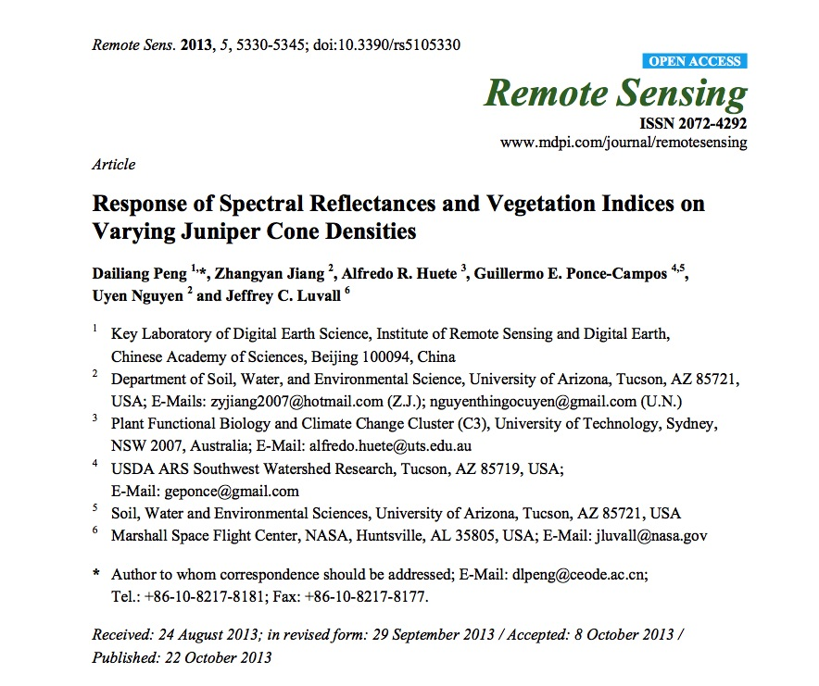

Slide 24
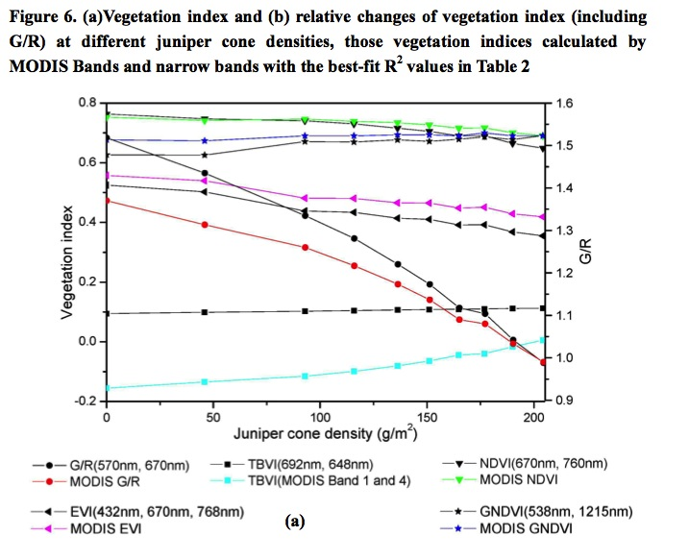

Slide 25
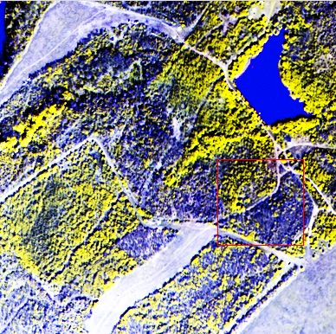
WV2 1/6/11 r=7(765-901) g=8(856-1043) b=442-515)
G/R ratio strongest sensitivity to cone density
G 545-565 & R 620-670 nm
VIIRS
G m4(545-565) R m5(662-682)
Notes:
R=765-901
G=856-1043
B=442-515

Slide 26
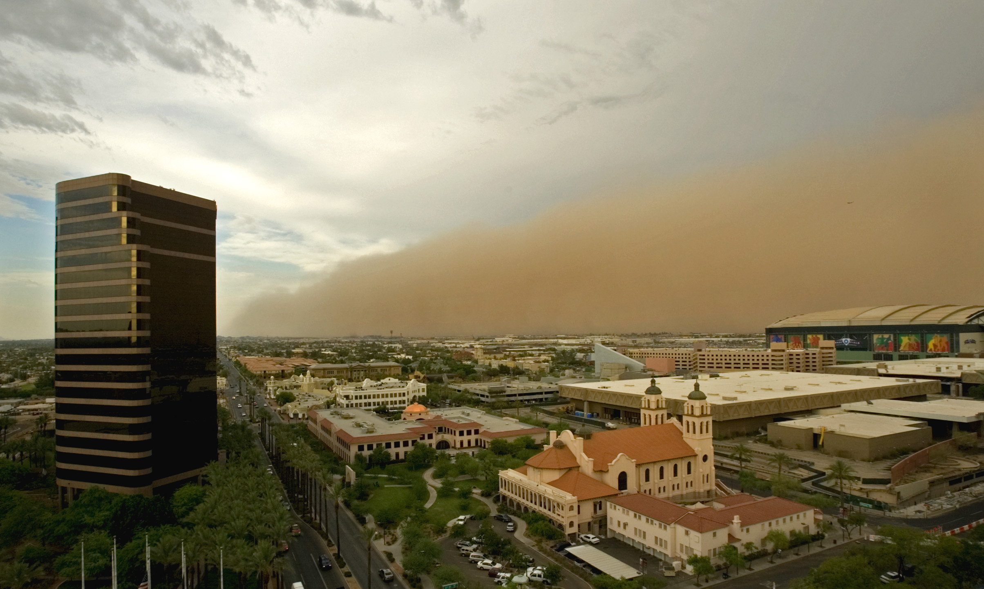
Airborne Dust Simulations and Forecasts
University of Arizona
With NASA Earth System Science & University of New Mexico
Phoenix dust storm – 7 June 2006
Photo by Robb Schumacher Arizona Republic
Department of Atmospheric Sciences
http://www.atmo.arizona.edu/faculty/research/dust/dust.html

Slide 27
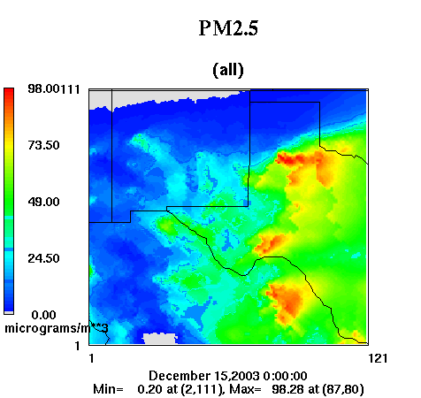
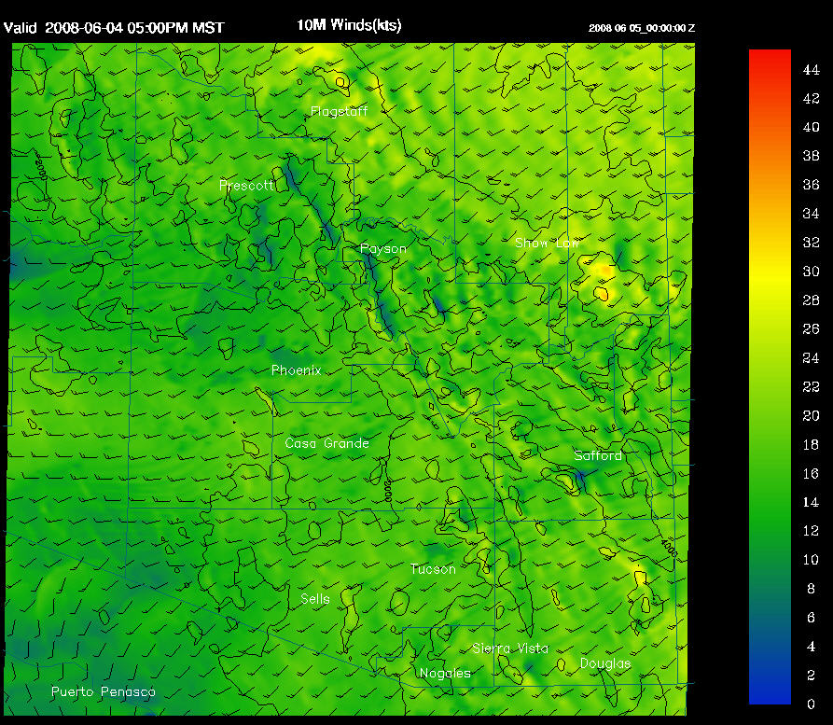
Weather - DREAM
Dust REgional Atmospheric Modeling (DREAM) system
MM5
WRF
S. Nickovic et al., A model for prediction of desert dust cycle in the atmosphere, JGR 106, 18113–18129 (2001) .
Yin et al., Modeling wind-blown desert dust in the southwestern United States for public health warning: A case study, Atmos. Environ. 39, 6243-6254 (2005).
Yin et al.,The impact of using different land cover data on wind-blown desert dust modeling results in the southwestern United States Atmos. Environ., 41, 2214-2224 (2007).
UA WRF 10-m wind forecast
Adapted from Betterton ppt
W.A.Sprigg for MSFC June ‘08

Slide 28
Weather - DREAM
Pollen - PREAM
Dust REgional Atmospheric Modeling (DREAM) system
MM5
WRF
Pollen REgional Atmospheric Modeling (PREAM) system
Model horizontal domain: Southwest US
Model resolution: ~19 to 40 km
Bins: 4, sized by pollen gain size distributions
Boundary conditions: driven by the NCEP/WRF
1 degree global forecasts used to refresh; initial conditions every 24 hours, boundary conditions every 6 hours
Model Output: Every 3 hr maps of pollen surface concentrations (grains/m³) out to 48 hrs.
UA WRF 10-m wind forecast
S. Nickovic et al., A model for prediction of desert dust cycle in the atmosphere, JGR 106, 18113–18129 (2001) .
Yin et al., Modeling wind-blown desert dust in the southwestern United States for public health warning: A case study, Atmos. Environ. 39, 6243-6254 (2005).
Yin et al., The impact of using different land cover data on wind-blown desert dust modeling results in the southwestern United States Atmos. Environ., 41, 2214-2224 (2007).

Slide 29
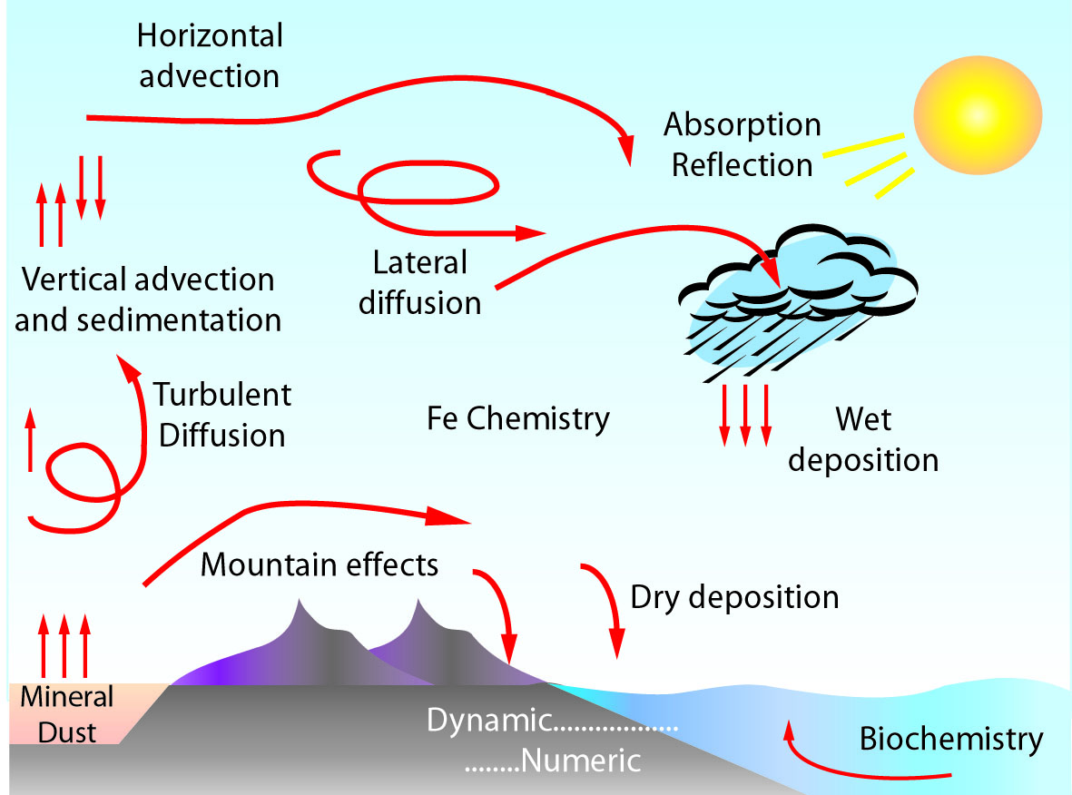
DREAM 4-8 particle bins
Model predictions (72-h):
Horizontal distribution
  Surface concentration
  Total column mass (dust load)‏
  Wet, dry, total deposition
  Meteorological variables
Vertical distribution
  Concentration
  Cross sections
  Fixed point/time profiles
Fixed point (selected sites/cities)‏

Slide 30
VERSATILE DREAM
Applications Have Included:
Dust Storms & Airborne Mineral Dust Concentrations in the Middle East, Africa and the Southwest US
Pollen in Colorado, New Mexico & Texas
Volcanic Ash in the Mediterranean
Soybean Rust in South America
A new test: Forest fire ash and smoke plumes
A proposed test: mold spores

Slide 31
Pollen Strategy
Select Pollen of Interest
Map Pollen Source
Estimate Emission on Test Date
Prepare Model
  Insert Terrain & Pollen Aerodynamic Characteristics
  Insert Source Emission
  Insert Meteorology
Simulate Downwind Pollen Dispersal
Evaluate

Slide 32
Pollen release potential Source Map/Mask
(PRPSM_of_J_{i}) of a Juniper species ‘‘i” is calculated as:
PRPSM_of_J_{i} = T_{i} × M_{i} × H_{i} × C_{i} × P_{i}
Where
T_{i} = Number of J_{i} trees
M_{i} = Male/Female ratio of J_{i}
H_{i} = HCP_LCP/All ratio for J_{i}
C_{i} = Cones per J_{i} tree
P_{i} = Pollen grains per cone for J_{i}
The number of trees of a Juniper species “i” per grid cell is calculated as
T_{i} = GAP_{i} × MODIS × TC
Where
GAP_{i} = Fraction of J_{i} at 1 km grid (range 0-1)
MODIS = MODIS derived percent tree cover per 1 km² grid cell (in fraction, range 0-1)
TC = Tree count or number of trees.

Slide 33
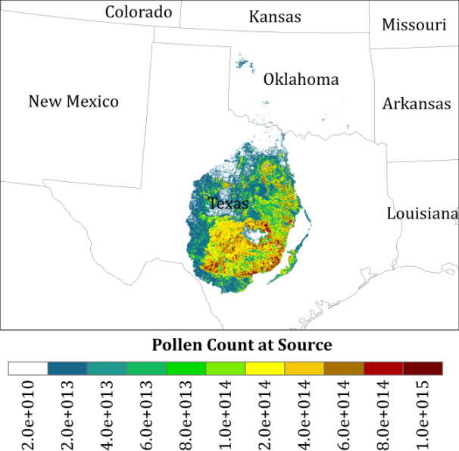
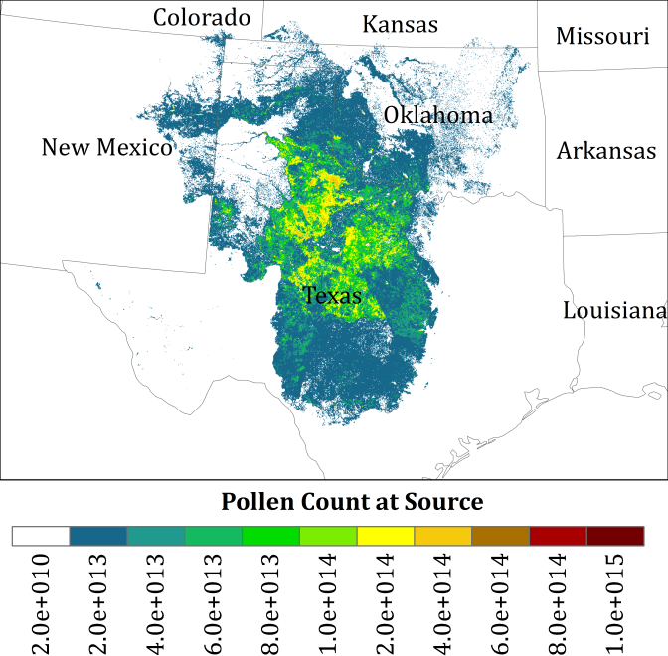
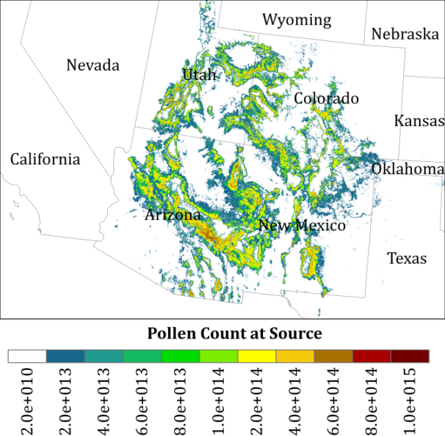
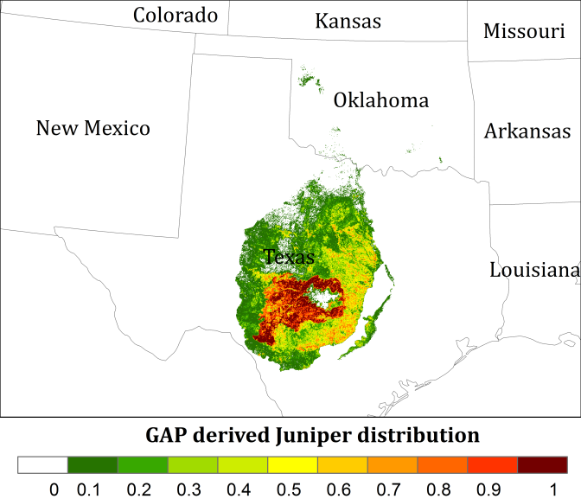
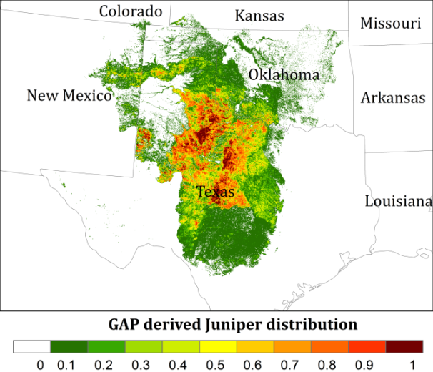
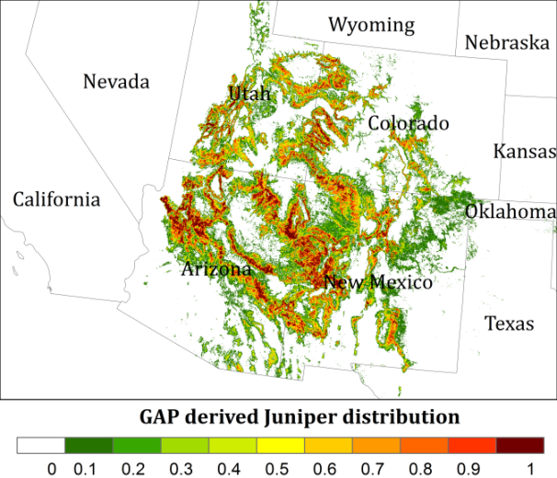
Juniper Ashei
Juniper Pinchotii
Juniper
Monosperma & Scopulorum
December to January
October-November
March-April
Pollen Source Mask (PREAM)
GAP derived distribution
Spatial resolution: ~1 km (990 m)

Slide 34
PREAM Quasi-operations (QO)
QO running at the UA
Model resolution: 1/3 deg (~37 km²) & 1/6 deg (~18.5 km²)
Daily forecasts
Products available on the UA ftp server:
  Maps for surface concentration (#/m^3), every 3 hours, 0-48h forecasts
  gridded values in ascii form; in #/m^3
  time-concentration graphs for the 0-48h forecast period for observation sites

Slide 35
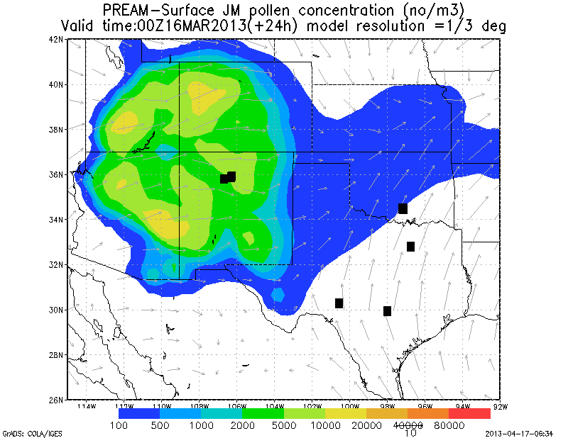
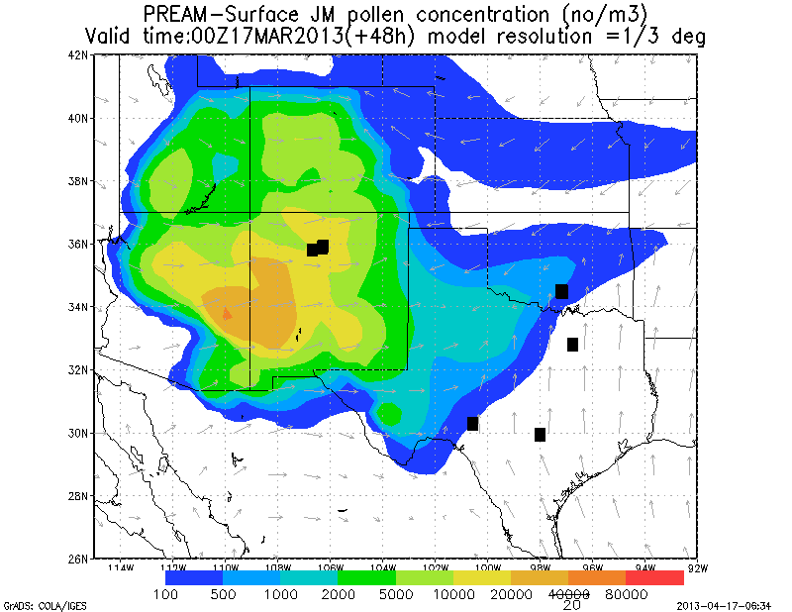
PREAM J. monosperma Plume Forecast: (L) 24-hr and (R) 48-hr

Slide 36


Slide 37
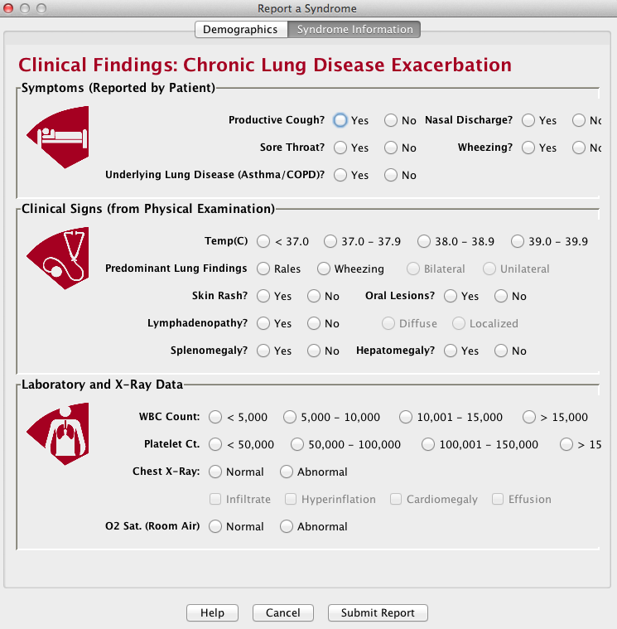

Slide 38
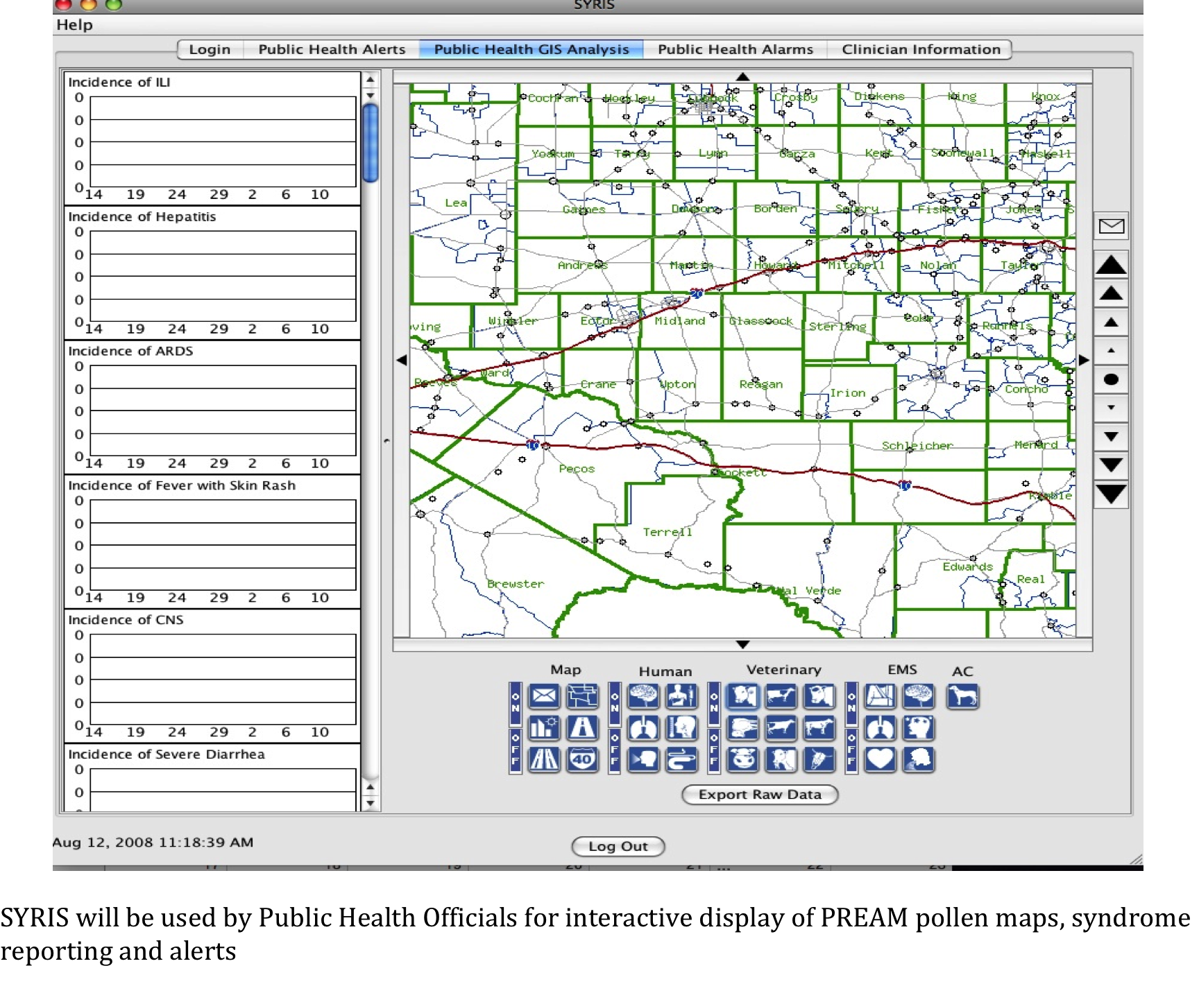

Slide 39


Slide 40
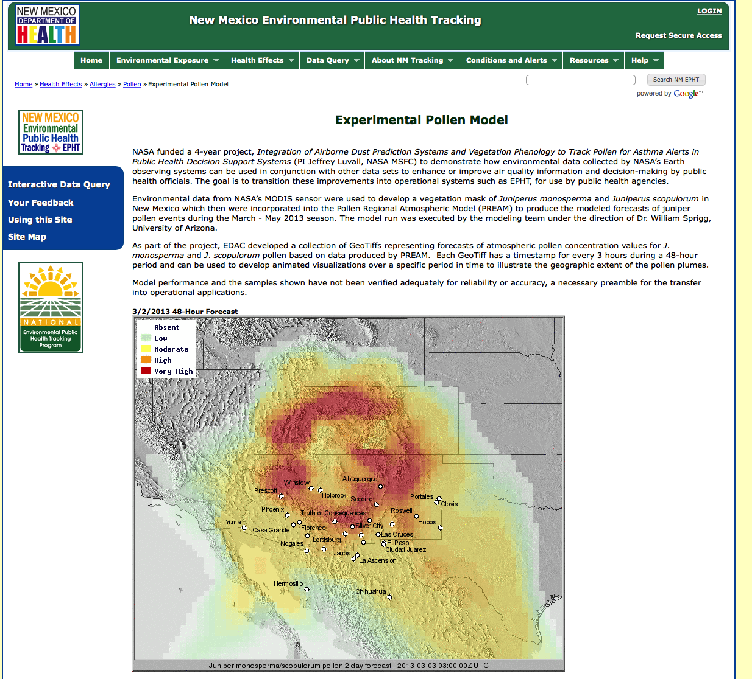
https://nmtracking.org/en/health_effects/allergies/pollen/pollen-model/

Slide 41
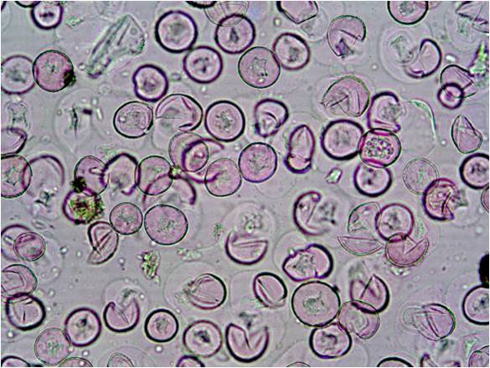
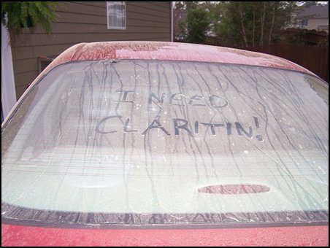

Thanks!

